Slide 1

Basic Details of the Team and Problem Statement
Ministry/Organization Name/Student Innovation : Student Innovation
PS Code: SIH1476
Problem Statement Title: Student Innovation
Team Name: DV_SubwayGuide
Team Leader Name: Nikhil Narayan Wagamore
Institute Code (AISHE): C-1428
Institute Name: Bapuji Institute of Engineering & Technology ,
Davanagere 577-004.
Theme Name: Transportation and Logistics

Slide 2
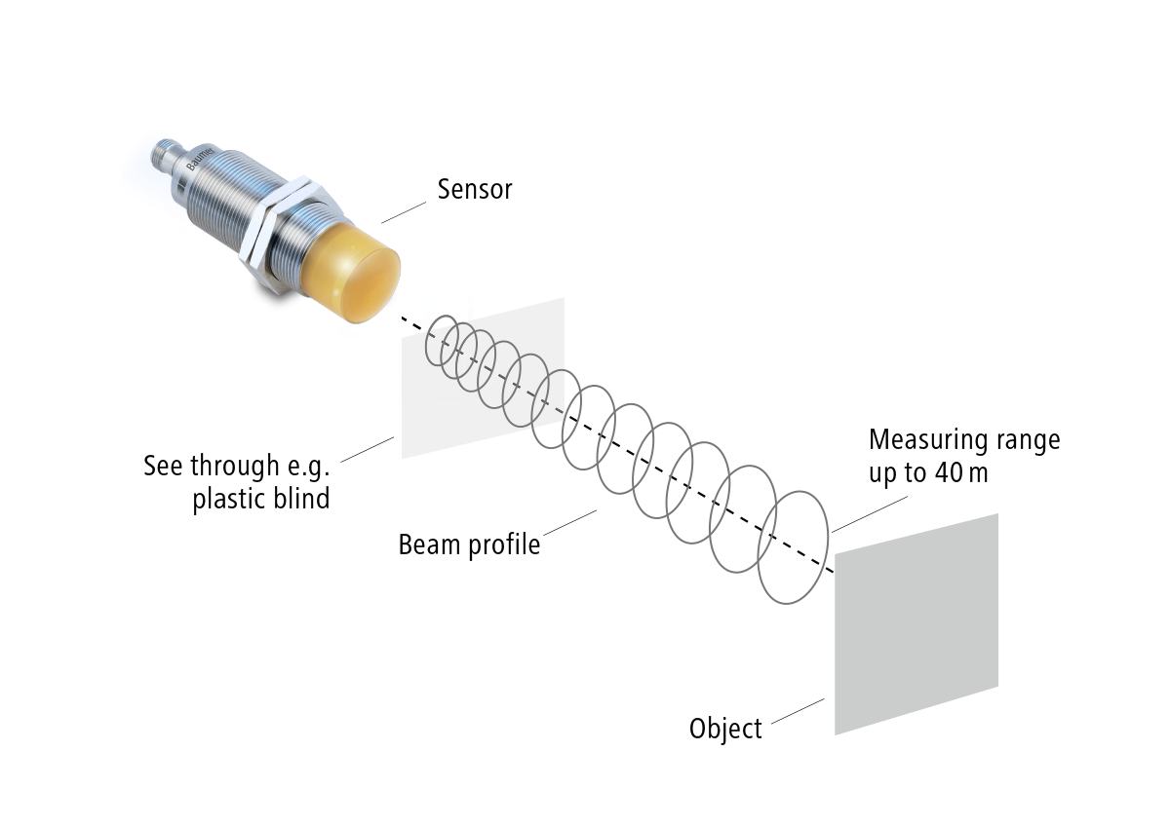
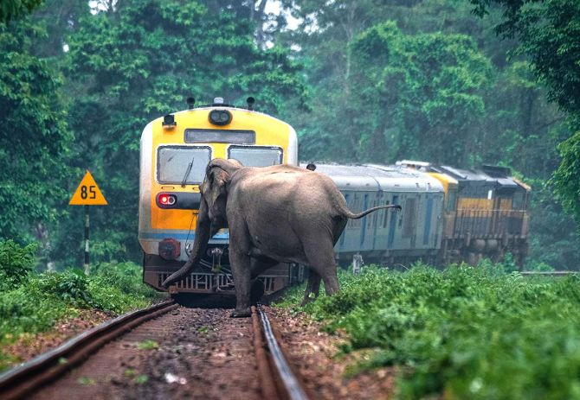
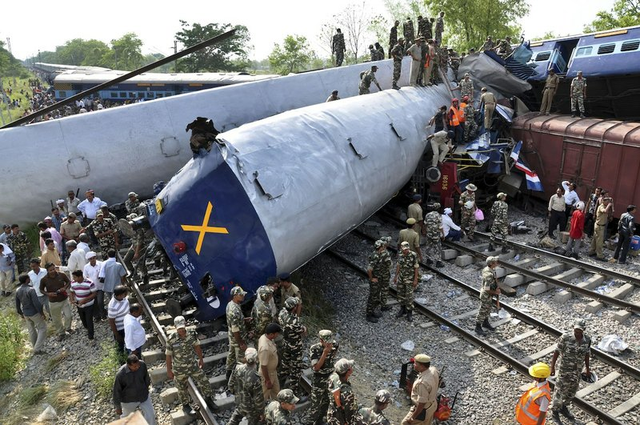
Idea/Approach Details
Object
(train)
RADAR sensor
Describe your idea/Solution/Prototype here:
Prototype to prevent an accident using a Radar sensor.
An object is detected within a definite distance.
A high-frequency (62 GHz) wave is going to hit an object which maybe biotic or abiotic and bounce back to the receiver.
That received signal is converted into image through ML algorithms.
The system will trigger an alarm or send a signal to the train operator or authorities to take necessary action.
If the train is not been stopped after detecting the object then the auto breaking system is applied to stop the train immediately.
This sensor evaluates the phase shift between the two frequencies.
Motor driver
Arduino
motors
Add process flow chart or simulated image of prototype or any relevant image related to your idea
Describe your Technology stack here:
Radar sensor :
Convert microwave echo signals electrical signals.
materials: Sensors, Arduino board, Display unit, Alarm.
Software _ Technology : Machine Learning
ODISHA TRAIN ACCIDENT ON 2nd JUNE

Slide 3
Idea/Approach Details
Describe your Use Cases here
Describe your Dependencies / Show stopper here
Develop and test perception, planning, and control algorithms for automated driving systems.
Great potential for classifying pedestrians and animals
Facilitates fast, precise, and resilient object detection & tracking to its long detection range.
Outstanding angle separability, and own chirp-sequence modulation feature.
RADAR SENSOR
TRANSMITTED
TRAIN
OBJECT DETECTED
REFLECTED
REFLECTED SIGNAL
CONVERT INTO IMAGE
PREPROCESSOR
Loco pilot
DEACCELERATED
ARDUINO

Slide 4
Team Member Details
Team Leader Name: Nikhil Narayan Wagamore
Branch (Btech/Mtech/PhD etc): B.E Stream :ISE Year (I,II,III,IV):II
Team Member 1 Name: Kavya Manjunathgouda Patil
Branch (Btech/Mtech/PhD etc): B.E Stream :ISE Year (I,II,III,IV):II
Team Member 2 Name: Prajwal M V
Branch (Btech/Mtech/PhD etc): B.E Stream : CSE Year (I,II,III,IV):II
Team Member 3 Name: Ratan Shet
Branch (Btech/Mtech/PhD etc): B.E Stream : CSE Year (I,II,III,IV):II
Team Member 4 Name: Yashavanth KS
Branch (Btech/Mtech/PhD etc): B.E Stream :ECE Year (I,II,III,IV):II
Team Member 5 Name: Vijayalaxmi Sthavarmath
Branch (Btech/Mtech/PhD etc): B.E Stream :ECE Year (I,II,III,IV):II
Team Mentor 1 Name : prof . Shwetha S
Category (Academic/Industry): Academic Expertise (AI/ML/Blockchain etc):ML/Image Processing Domain Experience (in years): 4
Team Mentor 2 Name: Type Your Name Here
Category (Academic/Industry): Expertise (AI/ML/Blockchain etc): Domain Experience (in years):

